Slide 1
Machine Learning Approach to Forecast Business Traffic and Sales
Fahad Alwarda
Feb 20, 2022

Slide 2
Objectives
Scope
Workflow
Forecast Traffic and Sales per hour for Jun 2018
Data Discovery
Data Preparation
Machine Learning Models
Performance Evaluation
Summary
Q&A

Slide 3
Scope
What: Develop an automated approach to estimate business traffic and sales for the upcoming month
How: By Building a data-driven model using machine learning techniques
Why: To identify benchmarks and determine incremental impacts of new initiatives, plan resources in response to expected demand, and project future budgets

Slide 4
Workflow
Data Discovery
Importing and Visualization
Univariant, Bi-variate Analysis, Nulls Treatment
Data Preparation
Cleansing, Aggregation, Features Engineering
Features Transformation, Data Splitting
Modeling and Evaluation
Modeling: LR, RFR, XGBR
Traffic and Sales Prediction

Slide 5
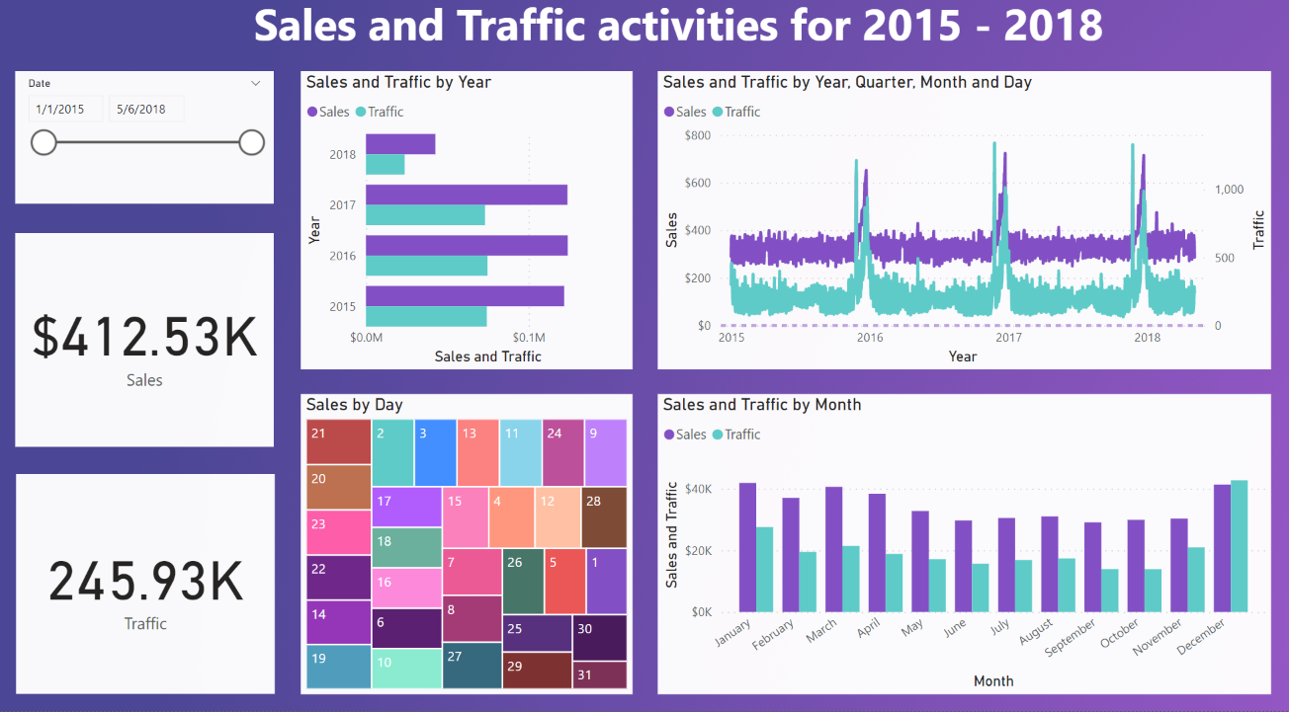
Data Discovery – Power BI Dashboard

Slide 6
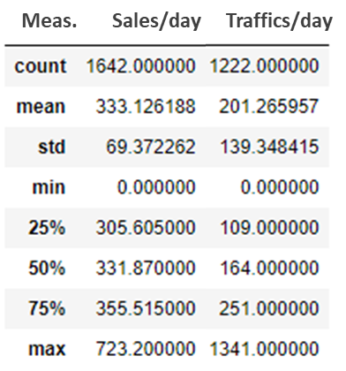
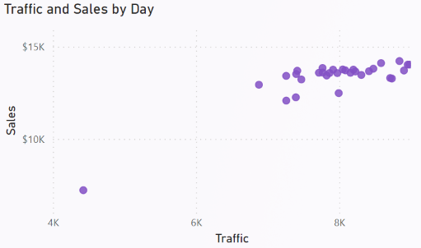
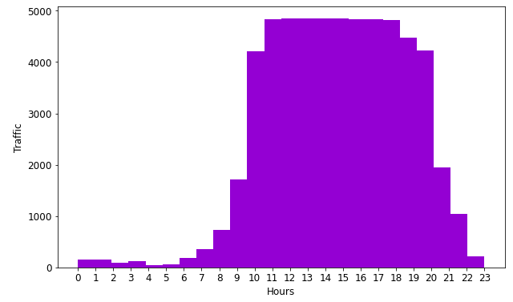
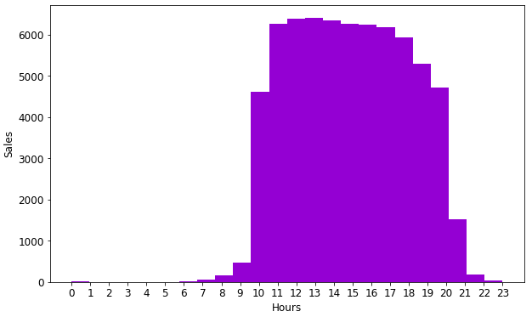
Data Discovery Summary
Sales and Traffic were constant around the year except during December.
Average sales/hr = $13.88, Average Traffic/hr = 8.39 visits
High sales and traffic were detected during the Black Friday sale and the holiday season
The strong correlation between traffic and sales confirms the data consistency
No missing values (Null, NaN) were Detected in the data
Zero sales or traffic activities weren’t recorded.
Sales were recorded between 6:00 AM and 11:00 PM while traffic was recorded during all hours

Slide 7
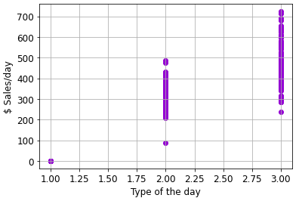
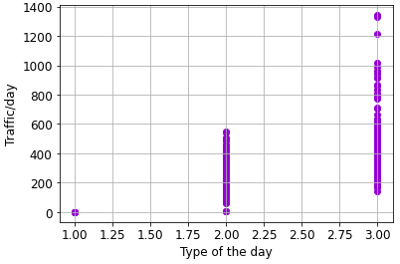
Data Preparation – Aggregation and Features Engineering
Data was grouped by days then aggregated to simplify and improve the modeling performance
Multiple days with zero sales were detected. (website maintenance assumed)
Date was converted into the day, month, year, numeric day of the week to build model features
Type of the day (dtype) was created to capture holidays, black Friday, and closed store events
dtype logic: zero traffic or sales: zero, normal days: 1, black Friday or December days: 3
Total of 10 features + Traffic and sales were used to build the models

Slide 8
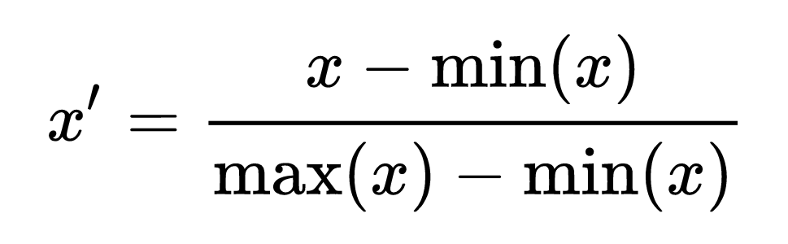
Data Preparation – Transformation and Splitting
Features dataset was normalized using the min-max normalization method to improve modeling performance
Transformed data range: min value = zero, max value = 1, and every other value gets transformed into a decimal between zero and 1
Features and targets were split into training (75%) – testing (25%) subsets
Data were split manually to capture the full-year sales and traffic variability. The testing dataset included the last 300 - 400 days of the dataset

Slide 9
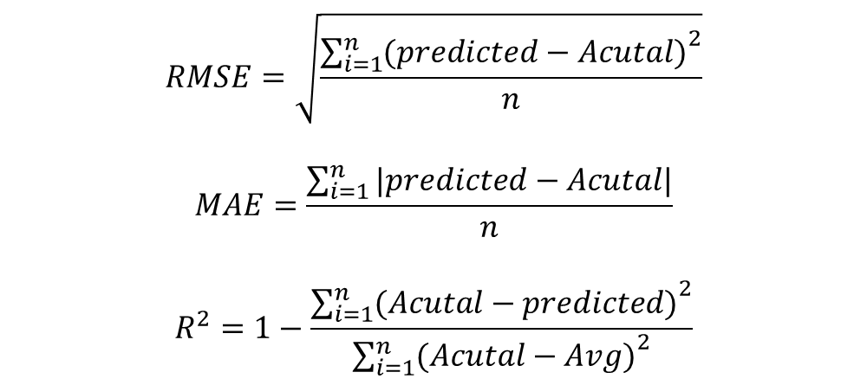
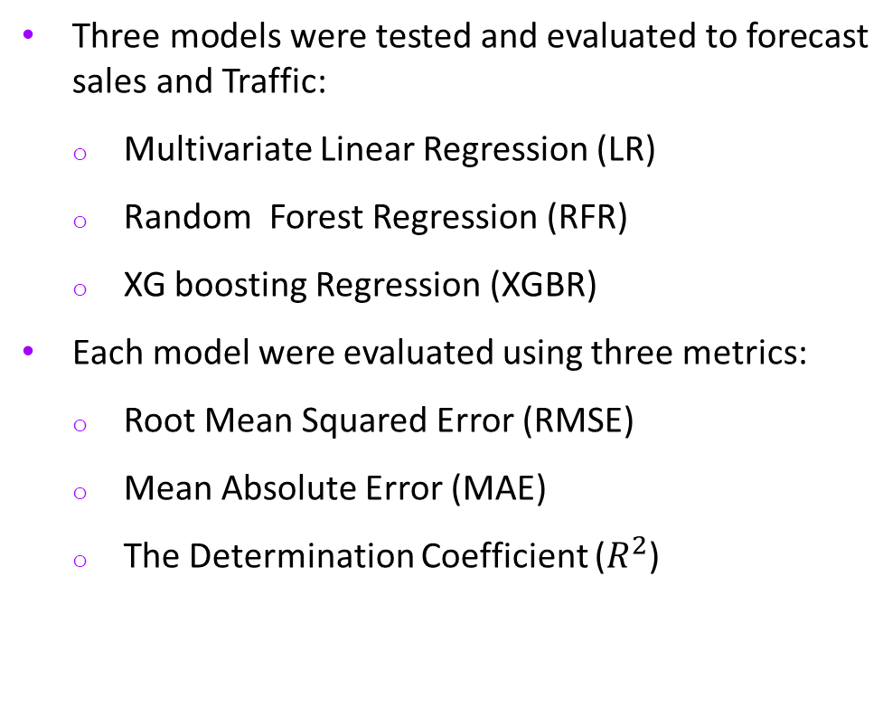
Data Modeling – Multivariant Linear Regression
Three models were tested and evaluated to forecast sales and Traffic:
Multivariate Linear Regression (LR)
Random Forest Regression (RFR)
XG boosting Regression (XGBR)
Each model were evaluated using three metrics:
Root Mean Squared Error (RMSE)
Mean Absolute Error (MAE)
The Determination Coefficient ($R^{2}$)
$$RMSE=\sqrt{\frac{{\sum_{i=1}^{n}{(predicted−Acutal)}}^{2}}{n}}$$
$$MAE=\frac{\sum_{i=1}^{n}{|predicted−Acutal|}}{n}$$
$$R^{2}=1−\frac{{\sum_{i=1}^{n}{(Acutal−predicted)}}^{2}}{{\sum_{i=1}^{n}{(Acutal−Avg)}}^{2}}$$

Slide 10
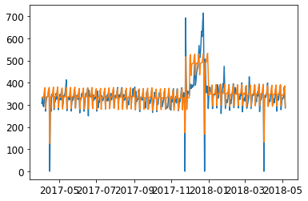
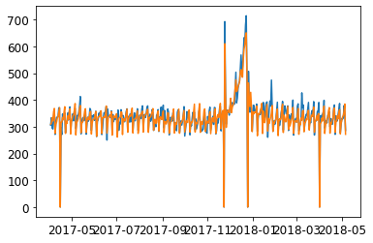
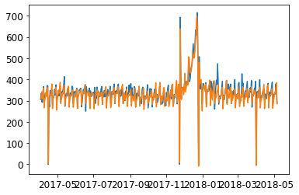
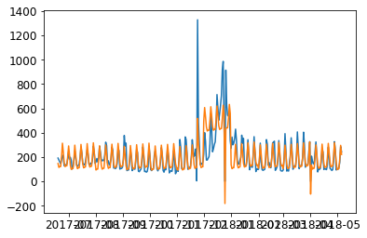
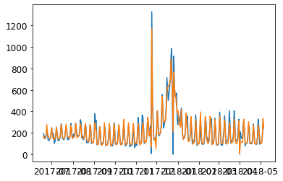
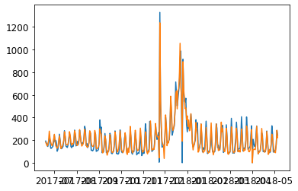
Sales and Traffic Forecast Models Predictions
Linear Regression | Random Forest Regression | XGBoost Regression
Sales
Traffic

Slide 11
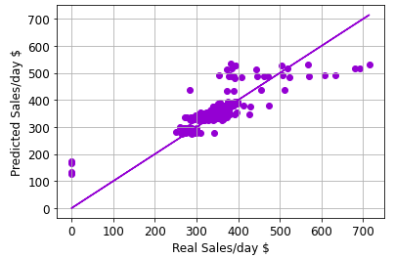
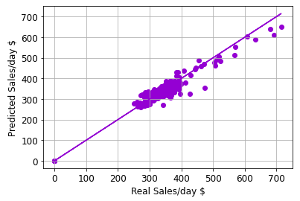
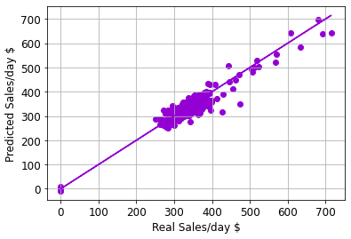
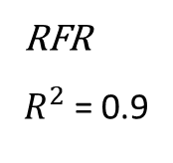
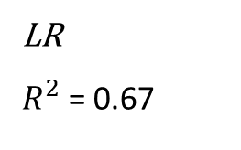
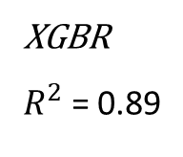
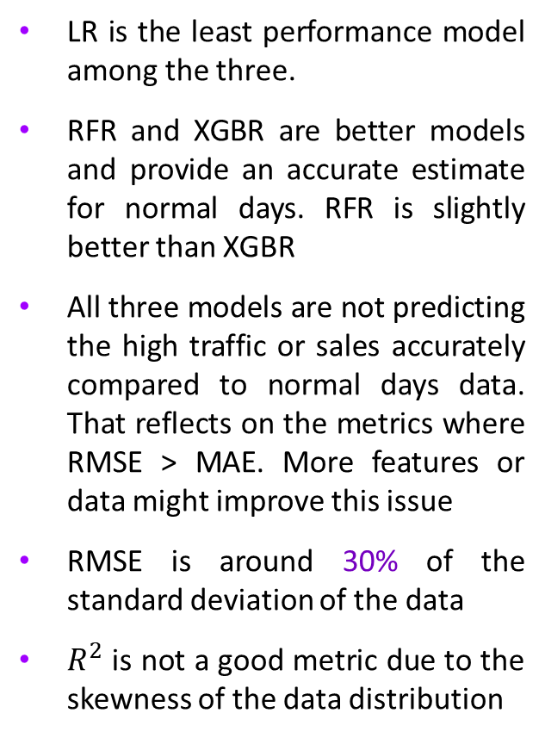
Sales Forecast Models Evaluation
LR is the least performance model among the three.
RFR and XGBR are better models and provide an accurate estimate for normal days. RFR is slightly better than XGBR
All three models are not predicting the high traffic or sales accurately compared to normal days data. That reflects on the metrics where RMSE > MAE. More features or data might improve this issue
RMSE is around 30% of the standard deviation of the data
$R^{2}$ is not a good metric due to the skewness of the data distribution
LR
$R^{2}$ = 0.67
1:1
RFR
$R^{2}$ = 0.9
XGBR
$R^{2}$ = 0.89

Slide 12
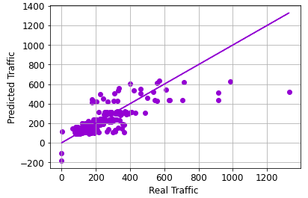
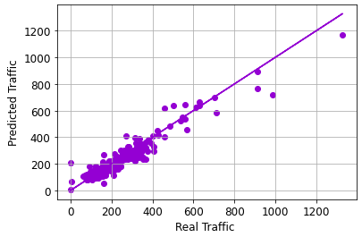

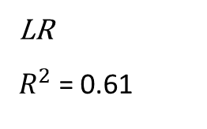
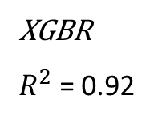
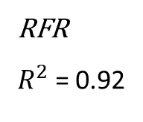
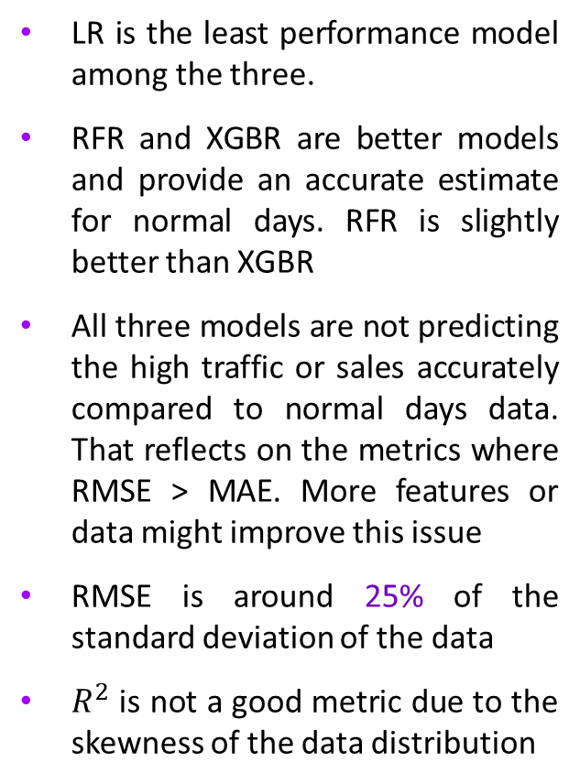
Traffic Forecast Models Evaluation
LR is the least performance model among the three.
RFR and XGBR are better models and provide an accurate estimate for normal days. RFR is slightly better than XGBR
All three models are not predicting the high traffic or sales accurately compared to normal days data. That reflects on the metrics where RMSE > MAE. More features or data might improve this issue
RMSE is around 25% of the standard deviation of the data
$R^{2}$ is not a good metric due to the skewness of the data distribution
LR
$R^{2}$ = 0.61
1:1
RFR
$R^{2}$ = 0.92
XGBR
$R^{2}$ = 0.92

Slide 13
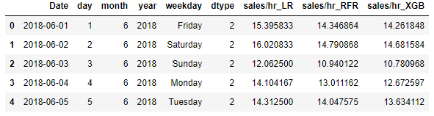
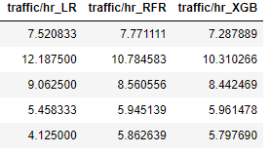
Forecasting Sales and Traffic for Jun 2018
Forecasting features were created for Jun -2018 with no holidays or special sales days.
All three models were used to forecast the daily sales and traffic then divided by 24 hrs to obtain the hourly rates
The average sales/hr for Jun 2018 is LR: $14.55, RFR: $13.83, XGBR: $13.69
The average traffic/hr for Jun 2018 is LR: 7.4, RFR: 7.7, XGBR: 7.8

Slide 14
Summary and Recommendations
Machine learning techniques were successfully used to forecast sales and traffics per hour
RFR provided a slightly more accurate estimation compared to the XGBR method. However, XGBR outperformed RFR in forecasting black Friday and December sales and traffic.
LR method was the least accurate model, especially in forecasting high sales/traffic per hour
Hyperparameter testing might be required to improve RFR and XGBR accuracy
Further testing and modeling (cross-validation, NN) are required to improve modeling
A simpler function is sufficient to forecast this data since the sales are flat throughout the years except during black Fridays and December months. A function that returns the averages of these three categories

Slide 15
Q&A

Slide 16
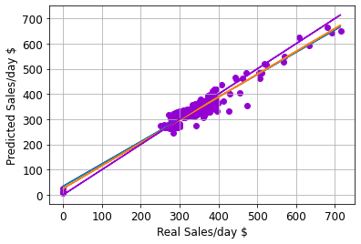
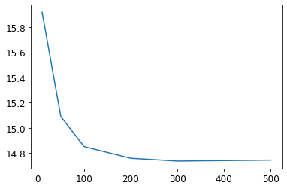
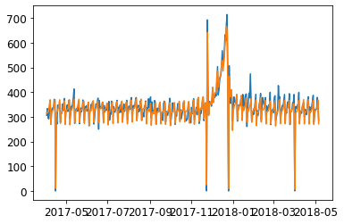
Testing, Hyperparameters tuning
CVRMSE: 20.15
MAE: 14.74
R2: 0.90

